Slide 1

Student Capstone Research in Thin Film Growth
Dennis Kuhl

Slide 2
Understanding the Physics of Surfaces
vacuum
atom in bulk
near-surface atom
Sensor technology
Tribology and lubrication
Miniaturization of electronics

Slide 3
Persson Volokitin Scattering Model
e
-
e
-
Specular Scattering
- clean surface
Diffuse Scattering
- caused by randomly distributed adsorbates
⇨ relates widely varied adsorbate-induced physical phenomena to a modification of the metal's surface electrical conductivity
a) resistivity change Δρ b) reflectance change
c) atomic scale friction d) antiabsorption resonances

Slide 4
Past Research Has Focused on Film Growth and Resistivity Modeling
Eric Reed
Chuck Flanagan
Meredith Rogers
Daniel Stanley
Xi Wang
Shaojie Zang
Laura Carpenter

Slide 5
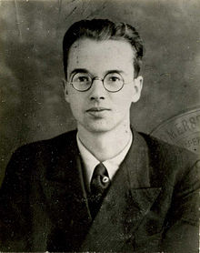
Klaus Fuchs
“The Conductivity of Thin Metal Films
According to the Electron Theory of
Metals,” Proc. Camb. Phil. Soc. 34, 100 (1938).
Police Photograph

Slide 6
Klaus Fuchs
“The Conductivity of Thin Metal Films
According to the Electron Theory of
Metals,” Proc. Camb. Phil. Soc. 34, 100 (1938).
Spied on British for Soviets
Spied on the US for British
Spied on US for Soviets
Convicted of espionage in Great Britain in 1950
Given maximum sentence of 14 years
Police Photograph

Slide 7
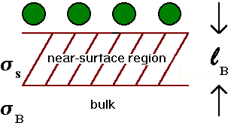
Fuchs Sondheimer Scattering Model
Matthiessen’s Rule:
p = specularity parameter
= fraction of conduction electrons
that scatter specularly from the surface

Slide 8
From D. Stanley Capstone
From this fit:
t₀ = 23 nm
p = -1.5

Slide 9
θ – 2 θ X-ray Diffraction
Tel-X-Ometer from Tel-Atomic
Can determine ordering perpendicular to the crystal face

Slide 10
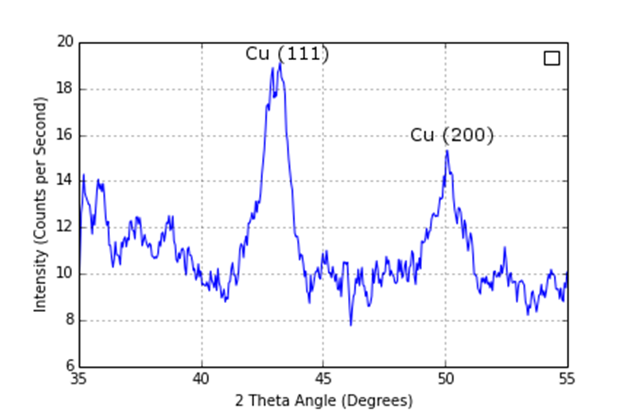
Bulk Polycrystalline Cu XRD Scan
From L. Carpenter Capstone

Slide 11
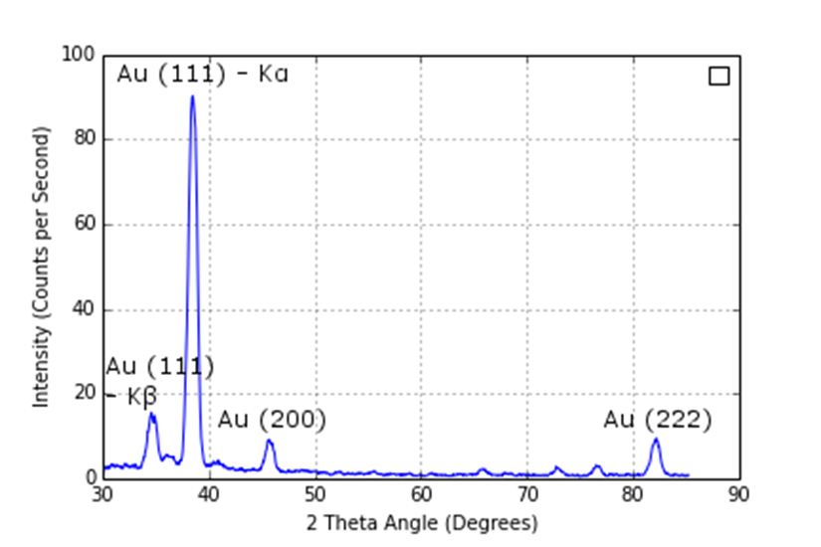
150 nm Au (111) XRD Scan
From L. Carpenter Capstone

Slide 12
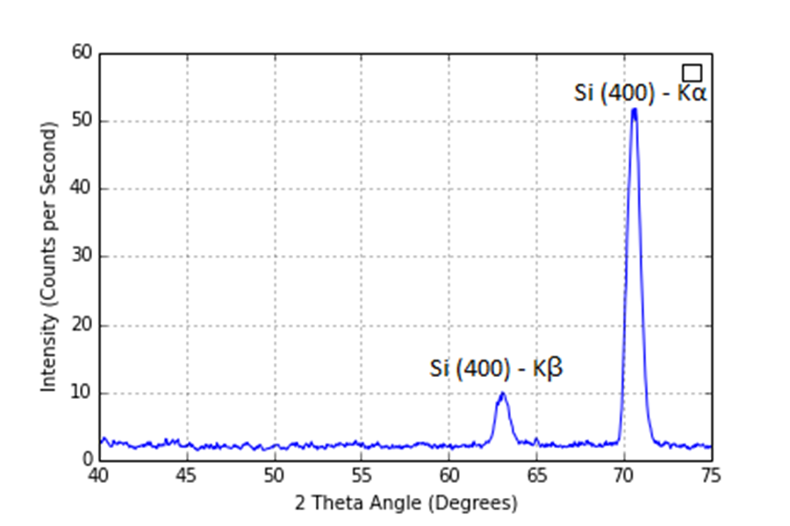
65 nm Cu on Si (100) etched
2 minutes in 2% HF
From L. Carpenter Capstone

Slide 13
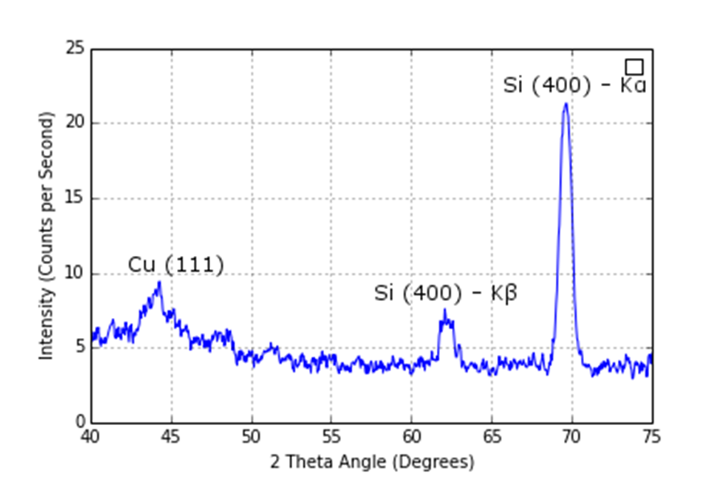
212 nm Cu on Si (100) etched
10 minutes in 2% HF
From L. Carpenter Capstone

Slide 14
Conclusions
Resistivity vs. thickness data by itself is not a sufficient measure of the quality of films.
None of the Cu films studied by XRD provided good evidence for epitaxy.
The thickest Cu film showed evidence of polycrystalline growth.
Surface physics research can be conducted in an undergraduate setting.

Slide 15
Conclusions
Resistivity vs. thickness data by itself is not a sufficient measure of the quality of films.
None of the Cu films studied by XRD provided good evidence for epitaxy.
The thickest Cu film showed evidence of polycrystalline growth.
Surface physics research can be conducted in an undergraduate setting.
Future Work: Repeat the study using 10% HF.

Slide 16
Future Work at MC
Methyl
Group
S
Au
Thioether adsorption on Au(111) films
Au films commercially available
Au easier to deal with in vacuum than Cu
Thioethers adsorb/desorb easily
Thioethers present a whole class of interesting adsorbates to test.
Alkane Thiols could be a related, additional class of adsorbates.

Slide 17
Thanks to …
All the students who have completed projects in the lab;
Department and college colleagues;
Roger Tobin for hosting a visit to his lab;
The Rickey family for incredible generosity.

